Slide 1
Consistency
Lecture 7

Slide 2
ACID Properties
Atomicity
Each transaction is “all or nothing” when it is committed.
Consistency
Any transaction will bring DB from one valid state to another.
Isolation
While multiple transactions can be executed by one or more users simultaneously, one transaction should not see the effects of other in-progress transactions.
Durability
Once a transaction is committed to DB, its changes are expected to save on disk even in the event of power loss, OS crash, or hardware failure.

Slide 3
Lock-based Consistency
When a session is reading a dataset, no other session can modify it.
When a session is modifying a dataset, no other session can read it.
Lock boundary can be defined by row-level or table-level in RDBMS.
It leads to deadlock, lock contention and low concurrency in DB.

Slide 4
MVCC - Multi-Version Concurrency Control
Multiple copies of data are tagged with timestamps or change identifiers.
DB uses these timestamps or versions to construct a snapshot of the DB at a given point in time.
If a session is modifying a DB table/row within a timeline--the time the session starts reading the data and the time the session finishes, DB uses previous versions of the data to ensure consistency among sessions.
MVCC ensures other sessions do not see the modifications until a transaction commits.
It gives transaction isolation, reduction in lock overhead and consistency while maximizing concurrency.
Most DBs use a global txn ID instead of timestamp. E.g. System change number (SCN) in Oracle and txn sequence number in MS SQL Server.

Slide 5
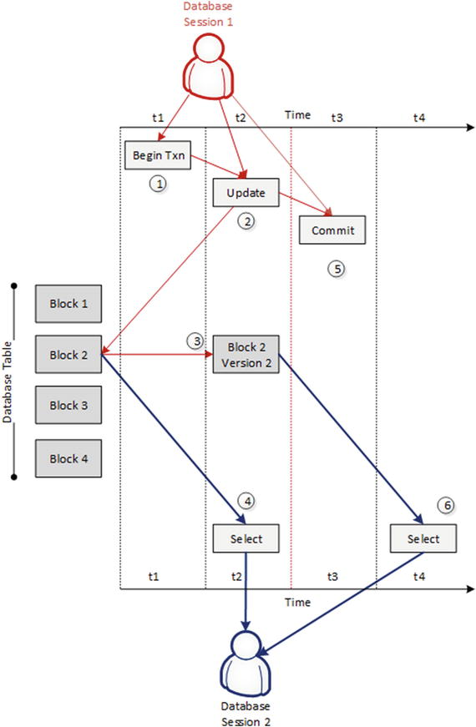
A DB session initiates a txn at time T1.
At time T2, the session updates data in a DB table.
This results in a new version (v2) of that data being created.
At the same time T2, a second session queries the same DB table. Since the txn from the first session has not yet committed, DB returns the previous version of the data.
The first session committed the txn in T3.
At T4, next query from the second session sees the modified version (v2) of the data.

Slide 6
BASE (ACID alternative)
It stands for Basically Available, Soft state, Eventually consistent.
ACID is pessimistic and forces consistency at the end of every operation.
BASE is optimistic and accepts that the DB consistency will be in a state of flux.
Best effort and faster.

Slide 7
What is consistency model?
A constraint on the system state observable by applications.
Example:
Data (X=1) is replicated on nodes M and N.
The client A writes X=2 to node N.
After a period of time T, the client B reads X from node M.
The consistency model has to determine whether the client B sees the write from client A (X=2) or not.

Slide 8
Client-side vs Server-side Consistency
Client-side Consistency
Shared state view from a client perspective on how the client observes data updates.
Server-side Consistency
How updates flow through the system and what guarantees the system can give with respect to updates.

Slide 9
Client-side Consistency

Slide 10
Strict Consistency
Each operation is stamped with a global wall-clock time
Rule: A read will always return the most recent data.
Examples:
Atomic read-write
Java CAS (Compare-and-swap) instruction.

Slide 11
Sequential Consistency
READs may not return the most recent value, but will return values in correct sequence--if one session created updates A, B, and C, another session should never see update C without also being able to see update B.
Sequential consistency is the closest to practicality.
Rules:
Each node sees the (WRITE) operations on the same memory in the same order although the order may be different from the real execution order.

Slide 12
READ your own WRITEs
This is a form of eventual consistency in which you are at least guaranteed to see any updates you executed.
In some cases, the consistency ties to the context of a DB session.

Slide 13
Eventual Consistency
It guarantees that if no new updates are made to a given data, eventually all accesses to that data will return the last updated one.
Support disconnected operations:
Better to READ a stale value than nothing
Better to save WRITEs somewhere than nothing
The inconsistency window makes a system felt nondeterministic and problematic.
In most cases, the system behavior is considered consistent and acceptable to the users despite we are relying on BASE in the implementation.
It is about trading consistency for availability.

Slide 14
Weak Consistency
The system makes no guarantee that it will ever become consistent in case of a server fails for instance.

Slide 15
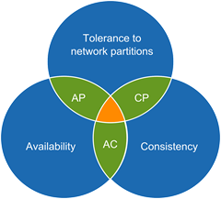
CAP Theorem
You can only pick 2 at a given point in time!

Slide 16
CAP Theorem
Consistency
All nodes see the same data at the same time.
Availability
A guarantee that every request receives a response about whether it was successful or failed.
Tolerance to network partitions
The system continues to operate despite messages cannot flow through between nodes.
Trade Offs
Scalability over consistency (AP over C)
Consistency over scalability (C over AP)

Slide 17
Fault-tolerance Systems

Slide 18
What can go wrong with a distributed system?
What if I can’t make the initial connection?
What if it takes ten minutes to make the connection?
What if I can make the connection and then it gets disconnected?
What if I can make the connection and I just can’t get any response from the other end?
What if it takes two minutes to respond to my query?
What if it takes additional retry to get a response?
What if 10K requests come in at the same time?
What if my disk is full when I try to log the error message about a Exception that happened because the network was bogged down with a worm?

Slide 19
What is fault-tolerant system?
Also known as graceful degradation or high-availability (HA) system.
A fault-tolerant system can continue operating properly in the event of the failure of some of its components.

Slide 20
Characteristics of a fault-tolerant system
No single point of failure (No SPOF)
Fault isolation to the failing component
Fault containment to prevent propagation of the failure
Support rollback to previous working version

Slide 21

Detecting failures using Heartbeats
Monitoring service sends a message to a heartbeat of a monitored node or process and waits for a reply.
If no response comes back within a predefined timeout interval, it’s declared as failed.

Slide 22
Problems with Heartbeats
Using a fixed timeout period between the two parties can cause a false alarm in case of high network traffic and high load on the nodes.
In a multithreaded application, the thread that’s serving the heartbeat can be in a corrupted state while other threads are healthy and vice versa.

Slide 23
Fault-tolerance by Redundancy
Supports multiple identical instances of the same system and switches to one of the remaining instances (backups) in case of a failure (failover).

Slide 24
Fault-tolerance by Replication
Provides multiple identical instances of the same system or subsystem and forwards tasks or requests to all of them in parallel.
Replication increases the reliability and availability of the system.
Two key replication patterns are:
Consistent hashing
Quorum-based replication

Slide 25
Fault-tolerance by Diversity
Provides multiple different implementations of the same specification and uses them like replicated systems to cope with errors in a specific implementation.
E.g. To send push notifications to mobile phones, re-route traffic to Amazon SNS whenever Twilio service is down.

Slide 26

Bulkheads

Slide 27
Bulkheads
If the hull of a ship is compromised, only the damaged section fills with water to prevent the whole ship from sinking.
Components of a distributed system are isolated into pools so that one failure cannot cascade to others.
Partition service instances into different groups based on load and availability requirements.
You can also partition the system by function—one set of servers for flight check-in and another set of systems to purchase tickets.

Slide 28

Circuit Breaker

Slide 29
What is Circuit Breaker?
Circuit breaker is a design pattern to detect failures and prevent cascading failures.
Generally, it can be used to check the availability of an external service.
E.g. Your app calls another app 100 times per second and the another app fails. You don’t want to have the same error raised constantly.

Slide 30
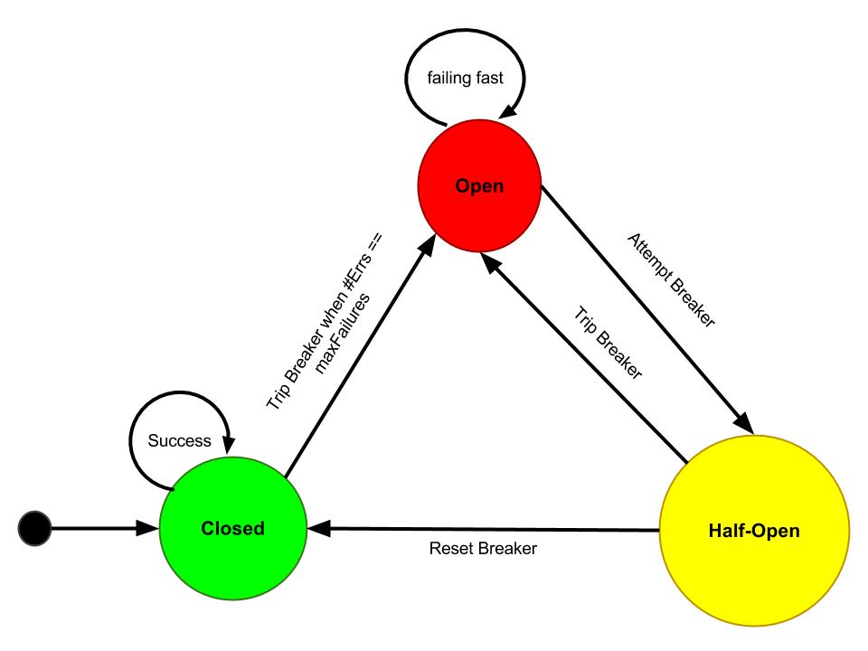
Circuit Breaker States
Configurations:
Max failures count
Call timeout
Reset timeout

Slide 31
How does a Circuit Breaker work?
During normal operation, a circuit breaker is in the Closed state:
Exceptions or calls exceeding the configured callTimeout increment a failure counter
Successes reset the failure count to zero
When the failure counter reaches a maxFailures count, the breaker is tripped into Open state
While in Open state:
All calls fail-fast with a CircuitBreakerOpenException
After the configured resetTimeout, the circuit breaker enters a Half-Open state
In Half-Open state:
The first call attempted is allowed through without failing fast
All other calls fail-fast with an exception just as in Open state
If the first call succeeds, the breaker is reset back to Closed state
If the first call fails, the breaker is tripped again into the Open state for another full resetTimeout.

